Slide 1
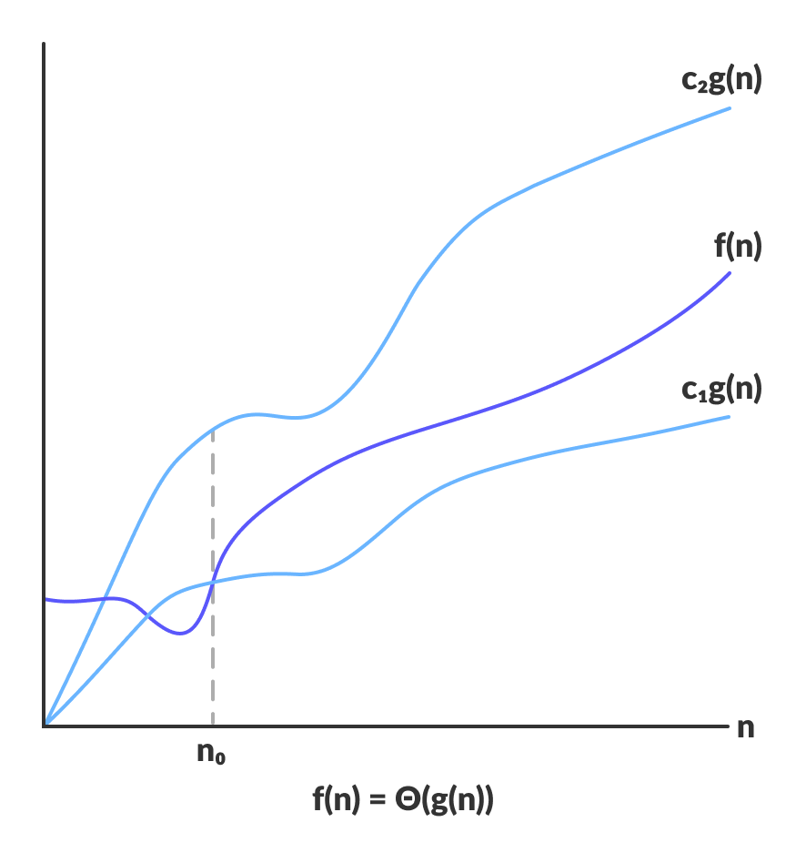
Analysis of Algorithms

Slide 2
Disclaimer / Descargo de Responsabilidad
Esta presentación corresponde a una guía usada por el profesor durante las clases. La misma ha sido modificada para ser utilizado en el modelo de cursos asistidos por tecnología. No es una versión final, por lo que la misma podría requerir todavía hacer algunos ajustes. Para aspectos de evaluación esta presentación es solo una guía, por lo que el estudiante debe profundizar con el material de lectura asignado y lo discutido en clases para aspectos de evaluación.
This presentation corresponds to a guide material used by the professor during classes. It has been modified to be used in the model of technology-assisted courses. It is not a final version, so it may still require some adjustments. For evaluation aspects, this presentation is only a guide, so the student should delve with the assigned reading material and what has been discussed in class.

Slide 3
What is an Algorithm?
An algorithm is “a finite set of precise instructions for performing a computation or for solving a problem
An algorithm is “a well-ordered collection of unambiguous and effectively computable operations that when executed produces a result and halts in a finite amount of time”
A tool for solving a well-specified computational problem, for example, sorting a list.
A recipe
Described in three parts: input, process and output

Slide 4
What is an Algorithm?
A computer program is the concrete representation of an algorithm in a programming language
An algorithm is “a finite set of precise instructions for performing a computation or for solving a problem
An algorithm is “a well-ordered collection of unambiguous and effectively computable operations that when executed produces a result and halts in a finite amount of time”
A tool for solving a well-specified computational problem, for example, sorting a list.
A recipe
Described in three parts: input, process and output

Slide 5

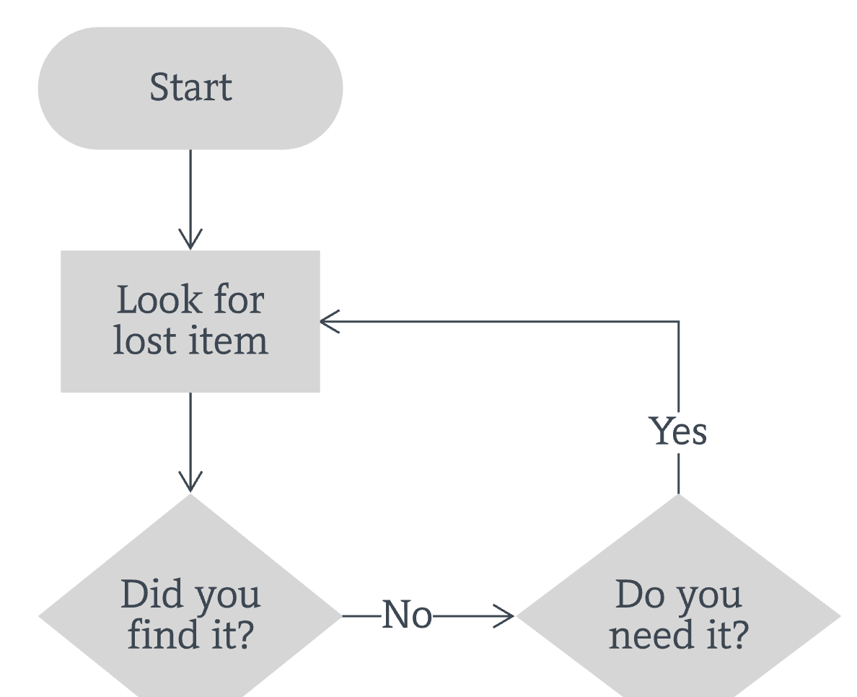
How to represent an algorithm?
PSEUDOCODE
NATURAL LANGUAGE
Input n
Set p to 1
While n is not equal to 0
Reset p to p * n
Reset n to n - 1
End of While
Return p
“the factorial of a non-negative integer n, denoted by n!, is the product of all positive integers less than or equal to n”
FORMAL DEFINITION
FLOW CHARTS

Slide 6
Characteristics of an Algorithm
Precise and with a clear sequence of steps. Running the algorithm several times with the same input, should generate the same output.
Finiteness: Terminate after a finite number of steps
Input/Output: must receive zero or more inputs and produce at least one output
Must be unambiguous: every step must be clear and have only one meaning
Effective: each operation must be basic and do what is supposed to do in a finite time

Slide 7
Effectiveness vs Efficiency
Effectiveness is about doing the right task, completing activities and achieving goals.
Efficiency is about doing things in an optimal way, for example doing it the fastest or in the least expensive way.
Algorithm efficiency is the property of an algorithm that indicates its consumption of computational resources such as CPU Time and Memory/Disk usage.

Slide 8
Algorithm Efficiency
There are many measures for the efficiency of an algorithm. The most commons are time and space. Other include:
Transmission speed
Temporary disk usage
Long-term disk usage
Power consumption
Response time
For the rest of this presentation, we will focus on time efficiency, which is the most commonly used metric

Slide 9
Factors affecting run time of a program
Computer System (CPU, Memory, Disk)
Compiler
Programing Language
Operating System
Developer
Size of input
Current applications running on the computer.

Slide 10



How to measure Algorithm Efficiency?
EMPIRICAL ANALYSIS
Very easy to understand and calculate
Is the act of running a computer program, a set of programs, or other operations, in order to assess the relative performance of an object, normally by running a number of standard tests and trials against it. Also known as benchmark
Results can vary depending on the hardware
Requires execution of the code
THEORETICAL ANALYSIS OF ALGORITHMS
Platform independent. Provides a better way to predict performance.
Is an important part of computational complexity theory, which provides theoretical estimation for the required resources of an algorithm to solve a specific computational problem
Hard to calculate and understand.
Calculated by just looking at the code.

Slide 11
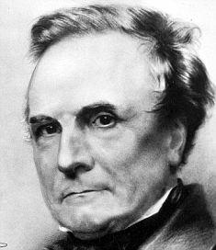

What is theoretical algorithm analysis?
“As soon as an Analytic Engine exists, it will necessarily guide the future course of the science.Whenever any result is sought by its aid, the question will arise—By what course of calculation can these results be arrived at by the machine in the shortest time?”
CHARLES BABBAGE
“It is convenient to have a measure of the amount of work involved in a computing process, even though it be a very crude one. We may count up the number of times that various elementary operations are applied in the whole process”
ALAN TURING

Slide 12
What is theoretical algorithm analysis?
It is the process of finding the computational complexity of algorithms – the amount of time, storage, or other resources needed to execute them.
Involves determining a function that relates the length of an algorithm's input to the number of steps it takes (its time complexity) or the number of storage locations it uses (its space complexity).
An algorithm is said to be efficient when this function's values are small, or grow slowly compared to a growth in the size of the input.

Slide 13
What is theoretical algorithm analysis?
Computational complexity theory focuses (part of computer science) on classifying computational problems according to their inherent difficulty, and relating these classes to each other.
It is the process of finding the computational complexity of algorithms – the amount of time, storage, or other resources needed to execute them.
Involves determining a function that relates the length of an algorithm's input to the number of steps it takes (its time complexity) or the number of storage locations it uses (its space complexity).
An algorithm is said to be efficient when this function's values are small, or grow slowly compared to a growth in the size of the input.

Slide 14
Why analyze algorithms?
Discover the characteristics of an algorithm in order to evaluate its suitability for various applications.
Compare an algorithm with other algorithms for the same application
Classify problems and algorithms by difficulty
Predict performance, compare algorithms, tune parameters
Better understand and improve implementations and algorithms

Slide 15
Approaches for theoretical algorithm analysis
1
2
COMPLEXITY AS A FUNCTION OF THE INPUT
ASYMPTOTIC BEHAVIOR
Calculate a function of the input size by counting elementary instructions, focusing on the worst-case or the average-case
Without calculating a detailed function of the input, focus on the behavior of the complexity for large n, that is on its asymptotic behavior when n tends to the infinity

Slide 16
Complexity as a function of input Elementary Instructions
Instructions that always takes the same time and this time is independent of the input size.
We don’t care about how many cycles the instruction needs to be executed
T is a variable which depends on the architecture and hardware, T denotes the time required to execute the instruction.
Basic Arithmetic Operators (+, -, /, %, ^)
Bitwise operators (<< , >>)
Logical operators (==, !=, and, or, ~ ...)
Jumps (returns values, method calls, ...)
Assignments, access to indexed structures.

Slide 17
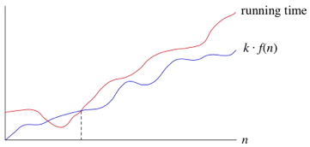
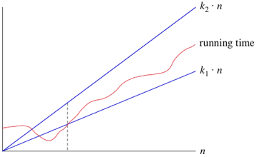
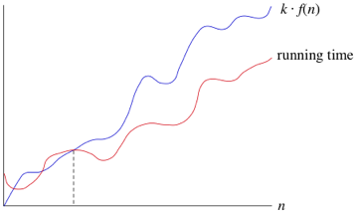
Complexity as a function of input Instruction/Step Count
Count the number of times each elementary instruction is executed. May be tedious to calculate the entire function.
The objective is to calculate three functions that describe:
Best-case
Average-case
Worst-case
Time it takes to run with the optimal input
Time it takes to run for any possible input. Very hard to calculate
Time it takes to run with the worst possible input

Slide 18
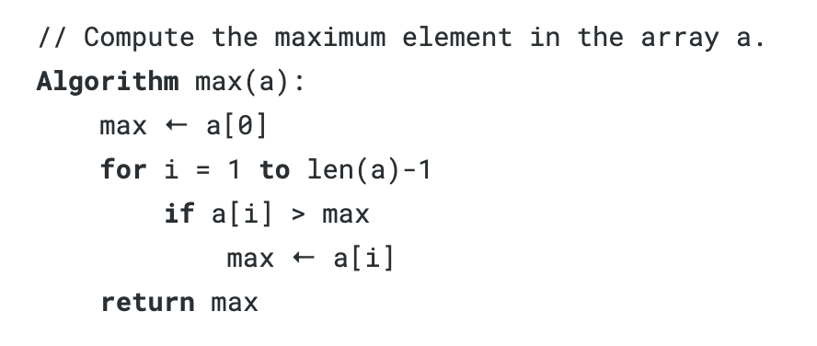
Complexity as a function of input Instruction/Step Count
Let's calculate the worst-case:
3T
2T
(N-1)*T
N*T
T + 2NT
2T(N-1)
2T(N-1)
T
Worst-Case:
T + 6NT
Worst-case time complexity gives an upper bound on time requirements and is often easy to compute. The drawback is that it’s often overly pessimistic.

Slide 19
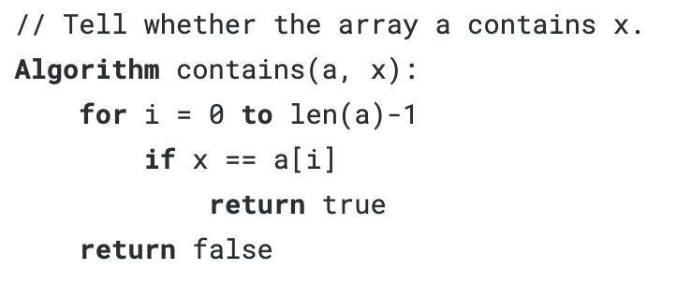
Complexity as a function of input Instruction/Step Count
Let's calculate the best-case:
2T
2T
T
Best-Case:
5T
The best case is finding the element at the first position of the array

Slide 20
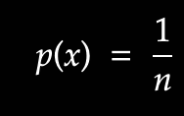
Complexity as a function of input Instruction/Step Count
To calculate the average case, one needs to consider any possible input and the probability to appear.
This is not usually calculated. Is not very straightforward and sometimes very hard.
For example, to estimate average case for linear search in an unsorted list, let's assume that the probability to find an element k in an array of n size is distributed uniformly, meaning, each the probability to find it in any position of the array is the same:

Slide 21
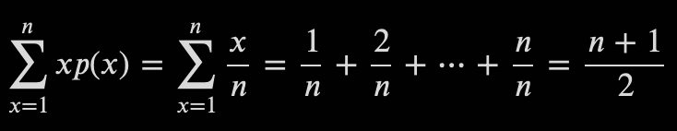
Complexity as a function of input Instruction/Step Count
So, the number of comparisons we have to do to find a value is:
As you can see, is not very easy to calculate. There are situations where the probability of the input is quite complex to calculate.

Slide 22
Complexity as a function of input Instruction/Step Count
Here are some tips to count instructions for common code structures (looking for worst-case):
#1
For a sequence of statements, sum the instruction count of each statement:
int i = 0;
boolean b = i == 1;
2T
3T
5T

Slide 23
Complexity as a function of input Instruction/Step Count
Here are some tips to count instructions for common code structures (looking for worst-case):
#2
For a conditional statement (like an if):
if (condition) {
first-branch
} else {
else-branch
}
Condition + Max(first-branch, else-branch)

Slide 24
Complexity as a function of input Instruction/Step Count
Here are some tips to count instructions for common code structures (looking for worst-case):
#3
For a for loop:
for (init; condition; increment) {
for-body
}
init
+
n+1 * condition
+
n * body
+
n+1 * increment

Slide 25
Complexity as a function of input Instruction/Step Count
Here are some tips to count instructions for common code structures (looking for worst-case):
#3
For a for loop:
for (int i = 0; i < n; n++) {
for-body
}
int i = 1
Done one time
i < n
Done n + 1 times
i++
Done n times
for-body
Done n times

Slide 26
Complexity as a function of input Instruction/Step Count
Some loops multiply or divide by two the control variable:
#4
i = 1;
while (i < 1000) {
//code
i = i * 2;
}
i = 1000;
while (i >= 1) {
//code
i = i / 2;
}
How many times is the loop body executed?

Slide 27
Complexity as a function of input Instruction/Step Count
MULTIPLICATION LOOP
DIVIDE LOOP
Iteration | i value
1 | 1
2 | 2
3 | 4
4 | 8
5 | 16
6 | 32
7 | 64
8 | 128
9 | 256
10 | 512
Iteration | i value
1 | 1000
2 | 500
3 | 250
4 | 125
5 | 62
6 | 31
7 | 15
8 | 7
9 | 3
10 | 1

Slide 28
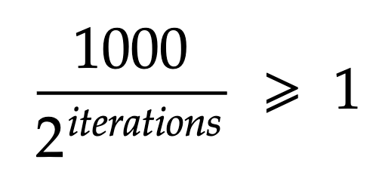
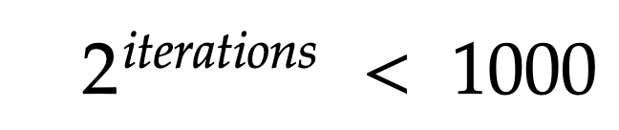
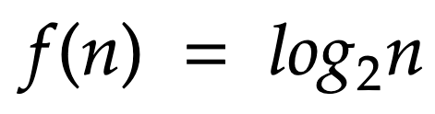
Complexity as a function of input Instruction/Step Count
MULTIPLICATION LOOP
DIVIDE LOOP

Slide 29


Complexity as a function of input Instruction/Step Count
MULTIPLICATION LOOP
DIVIDE LOOP
In the computational context: is taken as

Slide 30
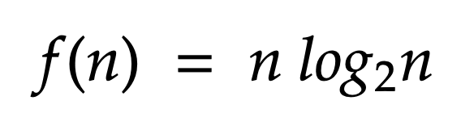
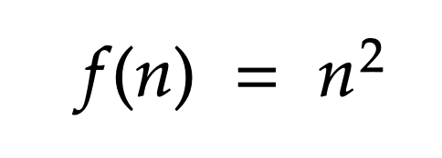
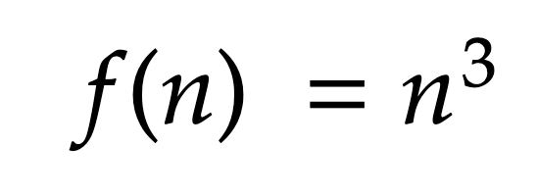
Complexity as a function of input Instruction/Step Count
To count the instructions of nested loops, we multiply the outer loop by the inner loop
There are several types of nested for loops, the most common include:
LINEAR LOGARITHM
QUADRATIC
CUBIC

Slide 31
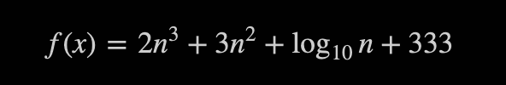
Asymptotic analysis
Is counting steps really worth it? Let’s say the function for a piece of code is:
Which term of the function determines its growth?
Input size (n) | f(n) | 2n³ | 3n² | log₁₀(n) | 333
1 | 338 | 2 | 3 | 0 | 333
10 | 2634 | 2x10³ | 3x10² | 1 | 333
100 | 2030335 | 2x10⁶ | 3x10⁴ | 2 | 333
1000 | 2003000336 | 2x10⁹ | 3x10⁶ | 3 | 333
10000 | 2000300000337 | 2x10¹² | 3x10⁸ | 4 | 333

Slide 32
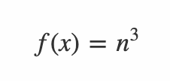
Asymptotic Behavior
Instead of looking for an accurate function, just focus on the growth rate of the algorithm
Based on the table we saw before, we can just drop the terms that does not contribute significantly to the growth of the function:
Under this approach, there are three notations

Slide 33
Asymptotic Behavior: Big O
Indicates the upper bound of the execution time of an algorithm
Upper bound. Run time won't get worse.

Slide 34
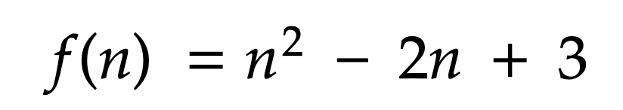
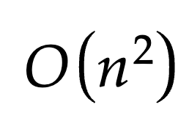
Asymptotic Behavior: Big O
ALGORITHM FUNCTION
ALGORITHM FUNCTION IN BIG O
BIG O DEFINITION
Be T(n) a function of the input n, T(n) is O(g(n)) if there is a n₀ and a constant c that for all n >= n₀ T(n) < cg(n)

Slide 35
Asymptotic Behavior: Big 𝝮
Indicates the lower bound of the execution time of an algorithm
Lower bound. Run time will get worse.

Slide 36
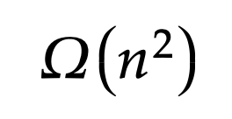
Asymptotic Behavior: Big 𝝮
ALGORITHM FUNCTION
ALGORITHM FUNCTION IN BIG 𝝮
BIG 𝝮 DEFINITION
Be T(n) a function of the input n, T(n) is 𝝮(g(n)) if there is a n₀ and a constant c that for all n >= n₀ (where n >= 1) T(n) >= cg(n)

Slide 37
Common Orders of Growth
1 | Constant
log n | Logarithmic
n | Linear
n log n | Linear Logarithmic
n² | Polynomial
n³
2^{n} | Exponential
n! | Factorial

Slide 38
Analysis of Algorithms

